Slide 1
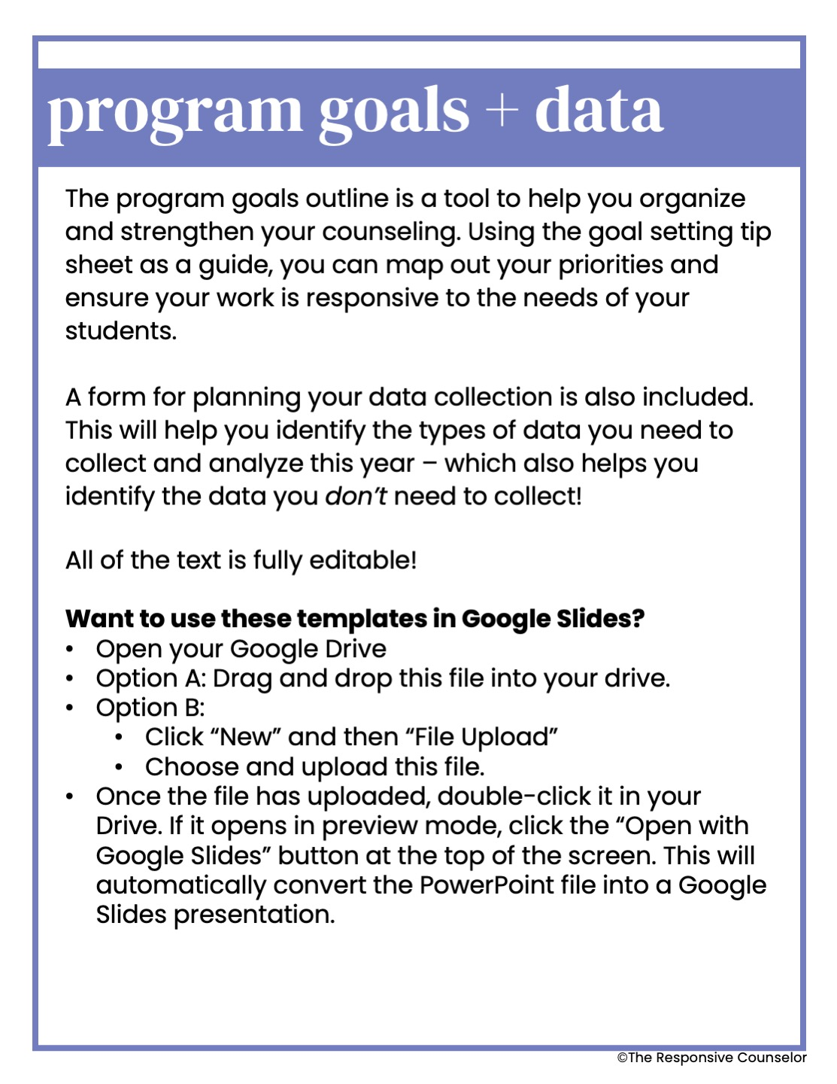

Slide 2

goal setting tip sheet
student impact/outcome goals
Big meaty goals that answer: How are students different as a result of the school counseling program? How have your services impacted the students in a noticeable way? Extra awesome when aligned to school improvement goals Make it SMART: specific, measurable, achievable, realistic, and time-bound
program process goals
How do you want to improve the school counseling program this year? More career programming? Use more data in small groups? Streamline behavior consultation with teachers? Start an advisory council?
personal/professional goals
How do you want to be more amazing as a counselor and a professional this year? Attend more meaningful PDs? Improve relationship with faculty? Use developmental theory more in lesson planning? Try out new classroom management techniques?
examples
academic | Students just below benchmark/grade level or who have specific low grades/test scores Subgroups with an achievement gap Ex: Increase the number of third grade students who get a passing grade on their quarterly reading tests by 15%
attendance | Tardies Absences (unexcused or combined) Ex: Reduce the number of students with 7+ tardies in Q1 by 25% in Q2
behavior | Referrals, suspensions, or time out of class (when they are removed/missing from class due to behavior and/or dysregulation) Ex: Identified 1st grade students will reduce their out of class time from an average of 2 hours/week in first semester to 1.5 hours/week or less in second semester
culture and climate | Specific measures or scales (PANORAMA, PBIS Apps School Climate Survey, Comprehensive School Climate Inventory, etc.) Single item like being able to identify a safe adult in the school building Ex: Increase the number of 5th grade students who say they feel safe at school by 10%
social emotional wellness | Percentage of students in tier 1 (low risk) vs tier 2/3 (moderate/high risk) on universal screener (SRSS, DESSA, etc.) Teacher or student pre/post survey on specific social emotional skills and competencies (positive communication, conflict resolution, responsible decision making, etc.) Ex: By the end of Q2, 80% or more of 2nd and 3rd grade students will demonstrate peaceful conflict resolution skills as evidenced by teacher survey.

Slide 3

counseling program goals
student outcome
Goal 1 goes here
Goal 2
And goal 3!
program process
Goal 1 goes here
Goal 2
And goal 3!
professional
Goal 1 goes here
Goal 2
And goal 3!

Slide 4
program data plan
data for planning
What do you need to plan for? What data will you collect and analyze for planning?
data for evaluating
What services or programming do you want to evaluate? What data will you collect to evaluate it?
data for advocating
What do you need to advocate for (or against)? What data will you collect and analyze to advocate?

